Slide 1

Rating Prediction
Rating Prediction:-
By Sharad Yadav
Guide-Mr.Keshav Bansal

Slide 2

INTRODUCTION
The rise in e-commerce, has brought a significant rise in the importance of customer reviews. There are hundreds of review sites online and massive amounts of reviews for every product. Customers have changed their way of shopping and according to a recent survey , 70 percent of customers say that they use rating filters to filter out low rated items in their searches.

Slide 3
Objective
The objective of rating project is that we have to build a model where
based on review and rating buyer can easily pickup item.
The ability to successfully decide whether a review will be helpful to other customers and thus give the product more exposure is vital to companies that support these reviews.

Slide 4

PREPROCESSING OF THE DATA
We have perform following pre-processing steps on dataset
1.Reading csv file
2. Removed punctuations
3. Extract numeric value from
4. Filling NaN values
5. Remove stop unwanted column

Slide 5
DATA MODELLING
Problem Analysis and transformation method
Extract numeric values from object data
I used Linear regression,Random Foreset ,Decision
Tree regression,XGB algorithm to build rating prediction model
The algorithm estimates the based on review and brand category determines rating

Slide 6
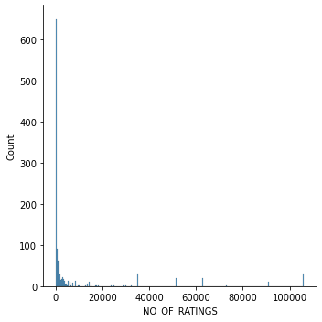
DATA VISUALIZATIONS
Visualization of no of rating

Slide 7
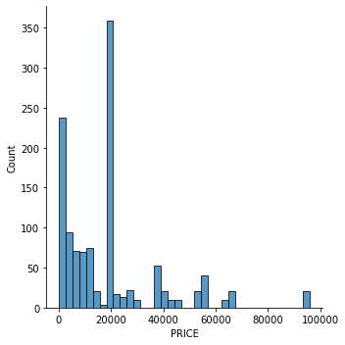
DATA VISUALIZATIONS
Price of product

Slide 8
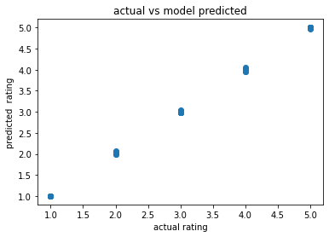
ANALYSIS OF RESULTS
Testing with different ML model , on the rating of product I have analyzed the following:
Based on brand and price rating of the product decide.
XGB model perform quite good among all model

Slide 9
CHALLENGES
Data mining is time taking and first I have to decide which column will paly important role during model building that is crucial.
Cleaning the data – Due to the object data numeric value mix with contain a lot of short forms which are different to classify using bag of words model.
Model accuracy and residual error is high that need to work still.

Slide 10
FUTURE SCOPE
The current project predicts the rating of review on listed item on amazon .
I am planning to add following features in the future work
1.Add more column like features of item which contribute to decide rating.
2.Handle mistakes and short forms of words to get better accuracy of the result.
Thank You

